Slide 1
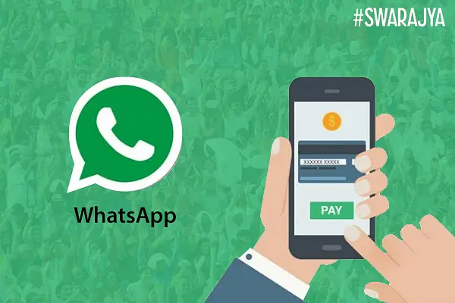
SIMPLILEARN PROJECT-3 WHATSAPP PAY G.RAJASHEKAR

Slide 2

SIMPLILEARN PROJECT-3 WHATSAPP PAY G.RAJASHEKAR

Slide 3
Sr.No | Title | Page No.
1. | Introduction | 4
2. | Business Objective | 5
3. | Identifying stakeholders | 6
4. | Identifying risks in this new feature | 7
5. | SWOT analysis for WhatsApp Pay feature | 8-11
6. | Transition State of WhatsApp Pay | 12
7. | As-is and future process map (using flowcharts) | 13-14
8. | In scope and out-of-scope items for this software f scope of this system | 15-16
9. | Main features that need to be developed | 17
10. | Business Requirements, Functional and Nonfunctional Requirements | 18-19
11. | Wireframes of the features | 20
12.
13.
14.

Slide 4
INTRODUCTION
1.WhatsApp is a messaging and Voice over IP (VoIP) service owned by Facebook. It allows users to send text and voice messages, make voice and video calls, and share images, documents, and other media. WhatsApp runs on mobile devices but is also accessible from desktop computers. WhatsApp has over 2 billion users worldwide as of today. It has become the primary means of electronic communication in multiple countries across multiple continents.
2.Today across the globe people are moving to digital payment services such as Google Pay, PayPal, and others. Mobile wallets are in massive demand. The transaction value of the global mobile payments market was USD 3714.5 billion in 2019 and is expected to reach USD 12,407.5 billion by 2025, registering a CAGR of 23.8%. WhatsApp being one of the leading mobile messaging apps wants to get a slice of this growing digital payment market.
3.WhatsApp has decided to take the plunge into this digital payment market. They have launched a new feature namely, WhatsApp Payments to be known as WhatsApp Pay in Brazil in June 2020. WhatsApp promises to disrupt the global digital payments ecosystem with WhatsApp Pay.
4.WhatsApp will integrate the customer’s bank details into their app. That is, while chatting with your peers, you can transfer the money to them. There will be no separate app that the customers need to download to access this payment feature. This feature would be provided to users as an update in the existing WhatsApp messaging app. The user can use WhatsApp pay feature by updating the WhatsApp messaging app.

Slide 5
OBJECTIVE
WhatsApp has decided to take the plunge into this digital payment market. They have launched a new
feature namely, WhatsApp Payments to be known as WhatsApp Pay in Brazil in June 2020. WhatsApp
promises to disrupt the global digital payments ecosystem with WhatsApp Pay.
WhatsApp will integrate the customer’s debit card or credit card into their app. That is, while chatting with
your peers, you can transfer the money to them. There will be no separate app that the customers need
to download to access this payment feature. This feature would be provided to users as an update in the
existing WhatsApp messaging app. The user can use WhatsApp pay feature by updating the WhatsApp
messaging app.
They are banking on the fact that the popularity of WhatsApp and the sheer number of WhatsApp users
(2 billion) will be an added advantage over other payment apps. Now, they have launched the feature in
Brazil, and it will be followed by a launch in India and then the rest of the world.

Slide 6
IDENTIFYNG STAKEHOLDER
FACEBOOK
BANKING SYSTEM
BUSINESS ANALYST
PROJECT MANAGER
PROGRAMMER
DOMAIN SME
IMPLEMENTATION SME
TESTER
OPERATIONAL EXPERT
WHATSAPP USERS

Slide 7
Identifying whatsapppay risk factors
Risk associated with whats app pay
No strong internet connection & knowledge
Not enough banking knoweldge& low trust
Online scams & other frauds
Not enough tested & no awareness

Slide 8
Whatsapp pay application swot analysis
Strength
Need online to use application
Data privacy and security at high risk
Opportunity
Global reach
Crypto wallet
Threats
Data breach
Compliance with regulations
Weakness
Easy and user friendly application
Huge customer base
Early bird in mobile wallet
One click money transfer
Need strong internet connection
Hackers and cyber theft easy
B2b money transfer
No limitation and easy access
Competition due to new innovation
Govt ban on whatsapp

Slide 9
SWOT analysis for WhatsApp Pay feature SWOT Analysis explained
3.1 Strengths
Use of superior technology One of WhatsApp’s biggest strengths is its use of superior technology, as such platforms are completely reliant on the technology they use. There have been no major outages in the recent past, and WhatsApp has the best connectivity.
Early mover advantage Because WhatsApp was one of the first to enter the instant messaging market, it has an early mover advantage with a loyal base.
Huge customer base In the social media business, the number of users on a platform is everything, and WhatsApp has already amassed a massive user base of over 2 billion users.
No major bugs in the application There have been no reports of serious bugs or technological failures in the application. Users demand and are getting a problem-free program for everyday use.
Supports all platforms The app is available on all platforms, including iOS, Windows, and Android, making it accessible to everyone.

Slide 10
3.2 Weakness
Data privacy remains a concern for users Data privacy is regarded as an ongoing concern for users. The company has yet to provide a complete solution to this problem.
Cannot function without internet Because the internet is required for the app to function, a large portion of the population that does not have access to the internet is still unable to be targeted.
3.3 Opportunities
Continuous technology development Technology is being developed every day with new customer requirements and a company such as WhatsApp has the opportunity to develop and sell the products which this new customer generation aspires to.
The Huge customer database can open up new revenue streams WhatsApp can provide an enormous opportunity for customer data to explore new revenue streams using this information.
Increasing Internet penetration in developing economies Even in developing countries, increasing internet penetration is a great way for WhatsApp to reach a number of users.
Smartphone Adoption The main advantage of WhatsApp is the global penetration and adoption of smartphones. This penetration has naturally aided the world’s leading instant messaging app.

Slide 11
3.4 Threats
Constant innovation in a competitive market The Internet is a wonderful tool; where new innovative ideas are generated on a daily basis. You never know which idea will destroy WhatsApp in which part of the world.
Low barriers to entry for new entrants Anyone can come and make a wonderful product like WhatsApp because it’s not a heavy investment service. The barriers are minimal, making it relatively simple for other players to join in on the game.
Changes in regulations to address any negative effects of WhatsApp communication Every new technology has flaws, and you never know when someone will use a technology maliciously. This is always a threat until everything is fully proven. Now that we’ve thoroughly explored WhatsApp’s SWOT Analysis, let’s wrap up the case study in the section below

Slide 12
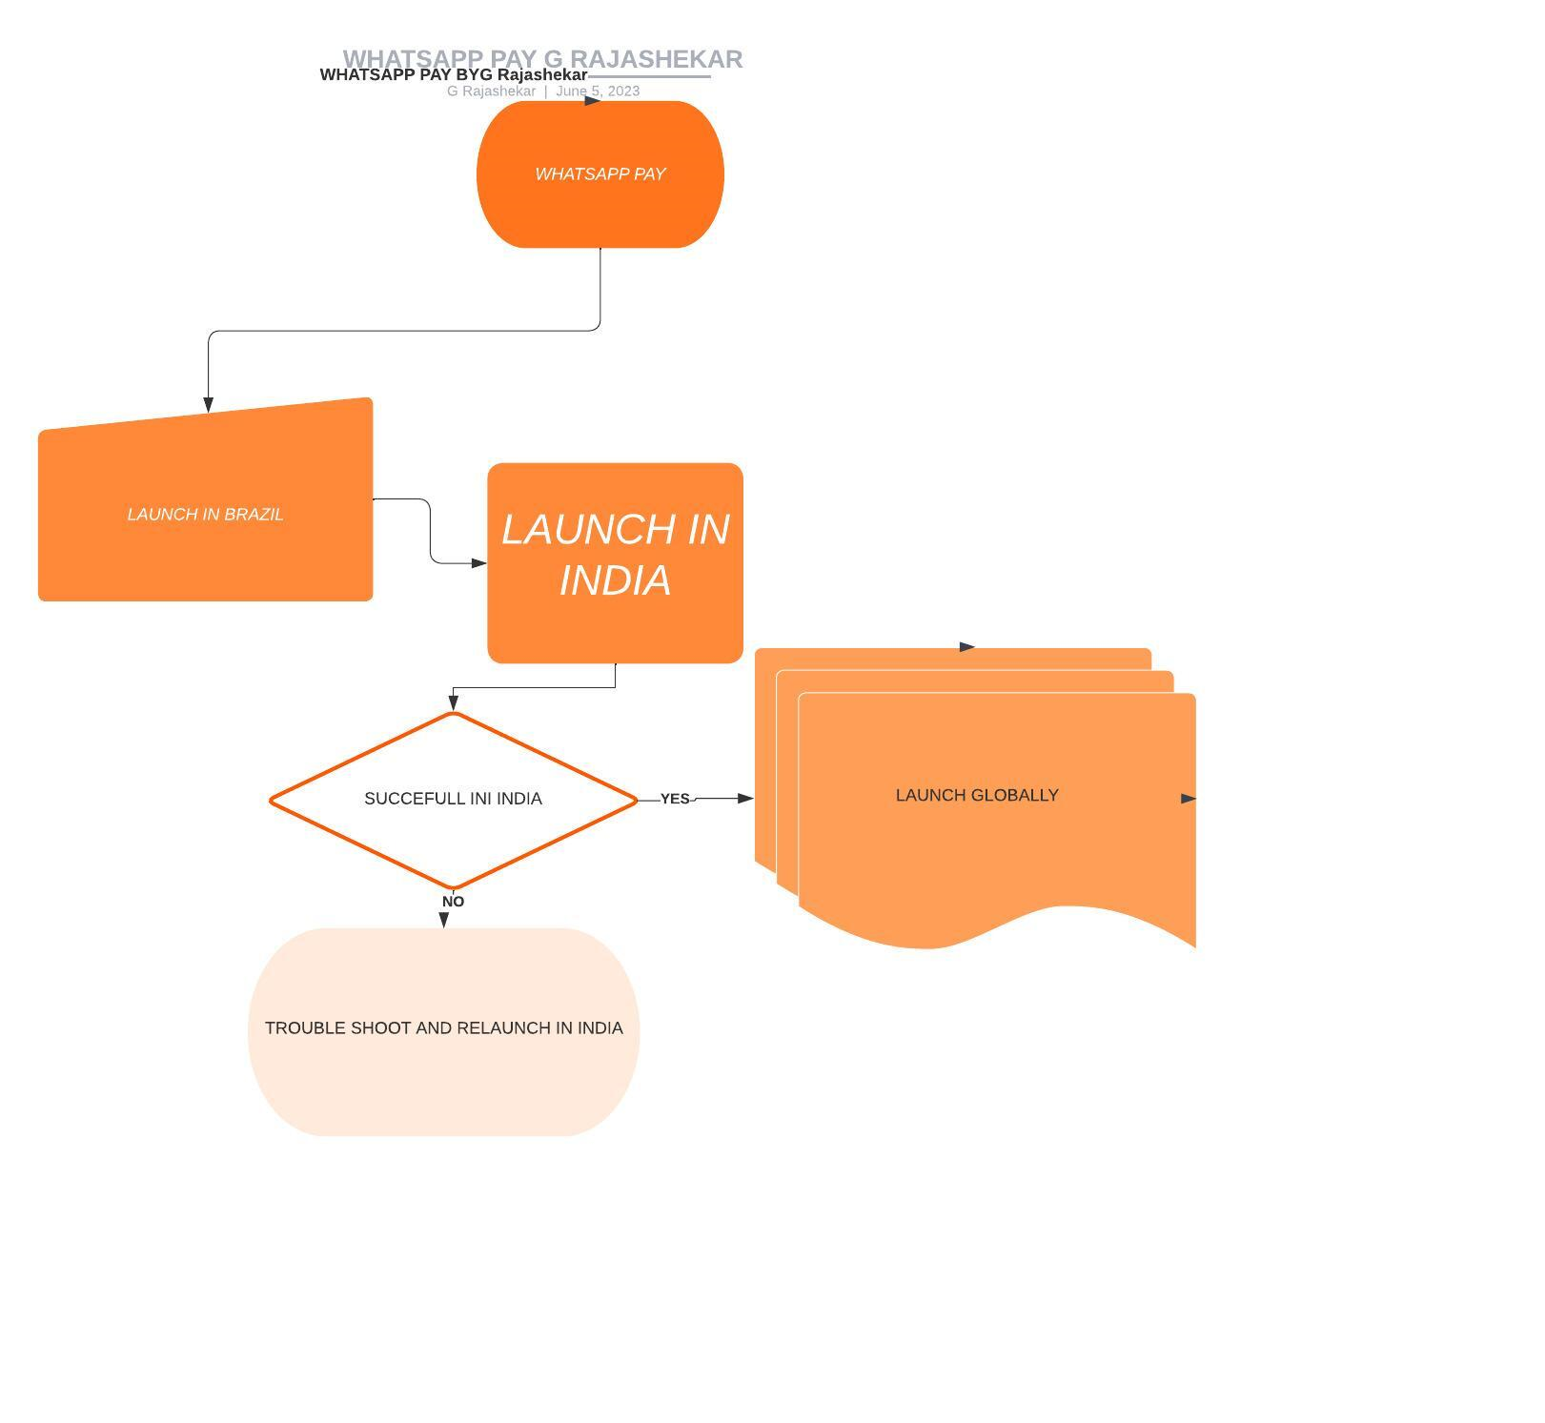
Identifying the Transition State of WhatsApp Pay

Slide 13
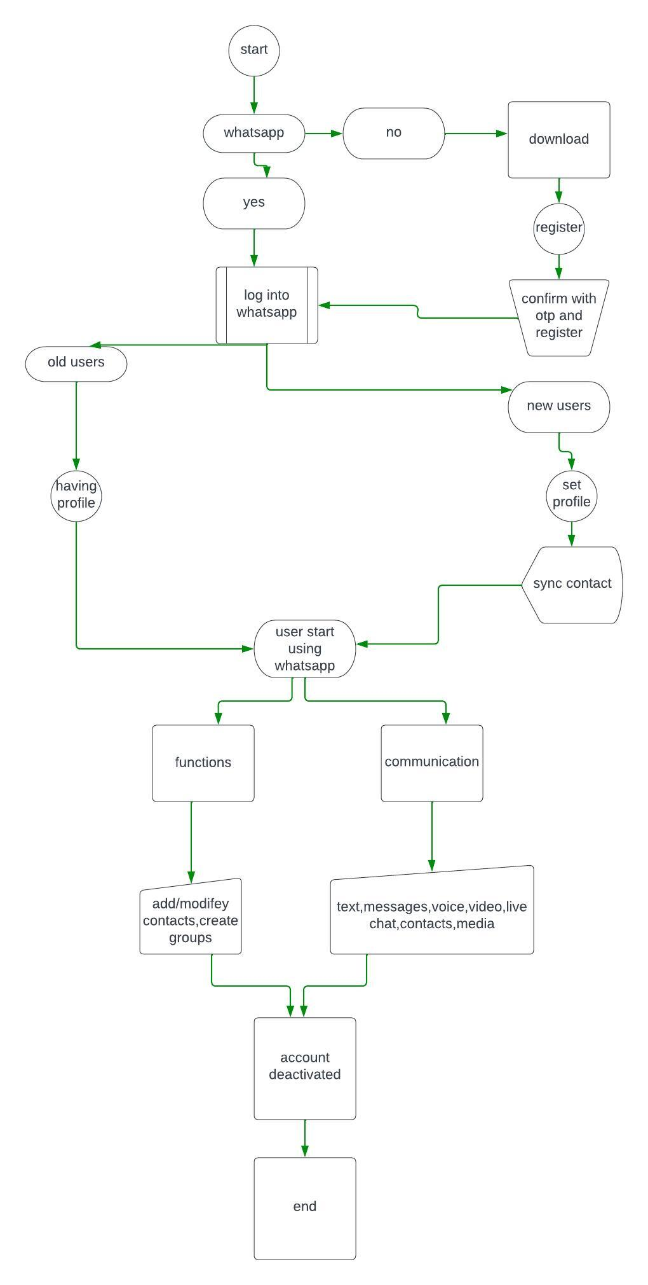
Whats app as is state

Slide 14
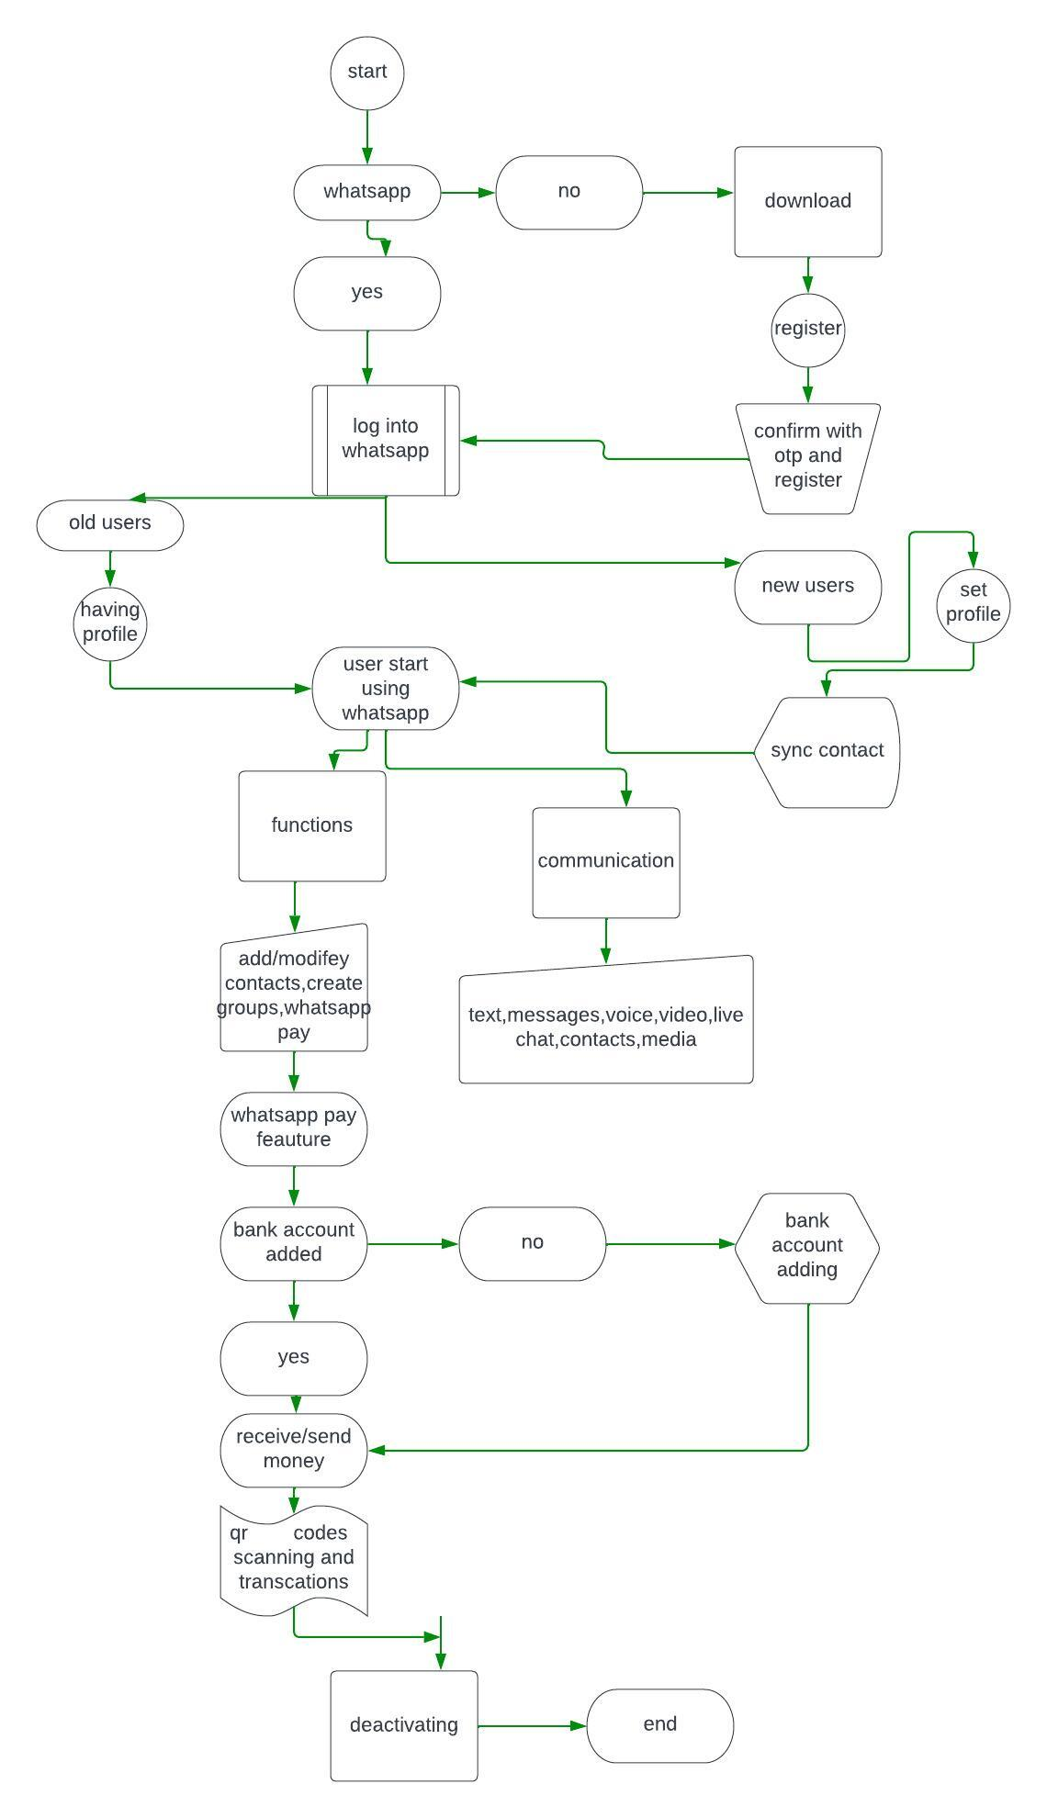
Whats app future state with whatsapp pay feature

Slide 15
8. In scope and out-of-scope items for this software
8.1 In- Scope Requirements for WhatsApp Pay
8.1.1 Setting up
Adding bank account to WhatsApp Pay account
Link debit and Credit card
8.1.2 Authentication
Credential management for payments
Smooth and secure integration with banks, payment service providers, payment gateways.
Payments process should be in line with local regulators
8.1.3 Functionality
Payment send and receive using WhatsApp Pay to and from contacts.
Notification after payment sent/received
QR code option to send/receive money
Transaction history should be visible and stored
8.1.4 Usability and Scalability
System should be scalable to rest of the world after testing in one geographical area
Available in multiple languages
Should be easy to use

Slide 16
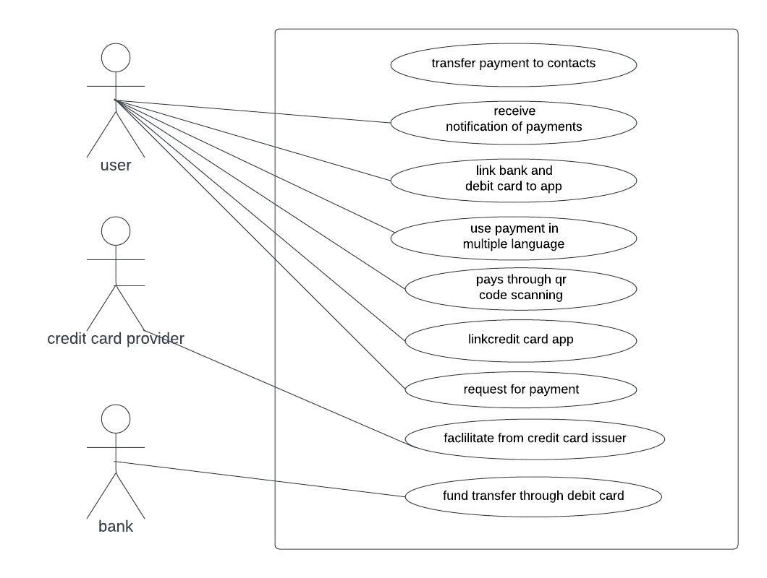
8.2 Out-of-scope Requirements for WhatsApp Pay
Users who do not have WhatsApp account will not be able to use the App.
Users need to setup bank accounts, else will not be able to use the feature
No e-commerce feature available
Any future interface is out of scope.
Scope using use case(uml) diagram

Slide 17
Main features of whatsapp pay
Integration of customers debit and credit cards into whatsapp
Along with communication users can send and receive money
One click transfer money across the world
Money can transfer in two methods
1.with contact name and send
2.with scanning qr code
Can send money securely and security pin will provide more safety for transactions
After transactions updates will receive both sides
Can request for money and on that request can send money also
Transaction history is available for every transactions can refer in future also
Whatsapp pay is available local language also will provide ease of using

Slide 18
9. Business Requirements, Functional and Nonfunctional Requirements
Functional User Account setup and synchronization with WhatsApp Pay payment receive or transfer system. Payment receive or sent synchronization could happen through Direct Account Pay (Via Debit Card) or Valid Credit Card.
Under the Settings menu, the user may access the Payment Account Details submenu.
The user can examine their debit or credit card data in Payment Account Details if they have already been uploaded to the system. If a user wishes, they can erase their credit card information.
To add new card information, click add and fill out the form with the account holder's name, account number, IFSC code, and card validity term.
The user's information would then be transferred to the bank's system, confirming and authenticating the user's card information. After obtaining authentication, The user card will be then linked to the user's WhatsApp account.
Only users with at least one legitimate card connected to their WhatsApp account can make digital payments. Furthermore, the transfer is limited to the Whatsapp user's contacts

Slide 19
9.2 Non-Functional
When introduced in an integrated fashion, the system should be expandable to accommodate more users.
The system must be safe. To maintain data security in transit and at rest, all transaction information should be end to end encrypted.
Regardless of the number of users, the system's performance should be within acceptable bounds

Slide 20
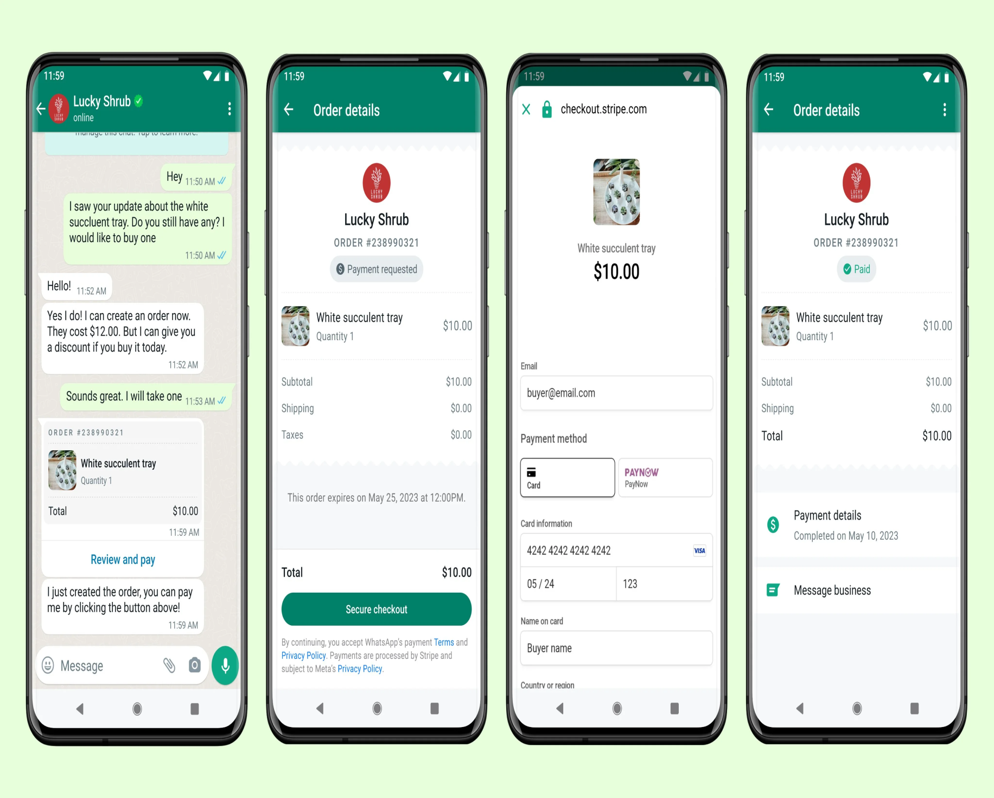
Whatsapp pay mockup screen

